Slide 1

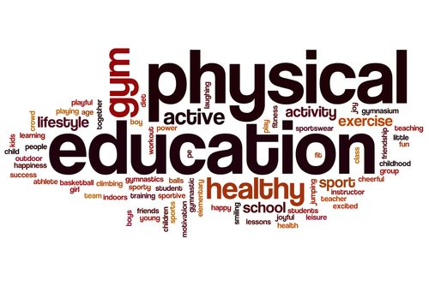


SHRI GURU GOBIND SINGH JI GOVT. COLLEGE,
PAONTA SAHIB, SIRMOUR (H.P)

Slide 2

B.A. 2nd YEAR
COURSE NAME: SPORTS PSYCHOLOGY
COURSE CODE: PED202TH

Slide 3

PSYCHOLOGY

Slide 4
TOPICS TO BE COVERED
PSYCHOLOGY
SPORTS PSYCHOLOGY
IMPORTANCE OF SPORTS PSYCHOLOGY
GOAL OF SPORTS PSYCHOLOGY

Slide 5
PSYCHOLOGY
According to the American Psychological Association, “The scientific study of the behavior of individuals and their mental processes.”
William McDougall (psychologist) defines, ” Psychology is a science which aims to give us better understanding and control of the behavior of the organism as a whole.”
John B. Watson defines, “Psychology is the science of behavior. “N. L. Munn defines, “Psychology is the science and the properly trained psychologist is a scientist or at least a practitioner who uses scientific methods and information resulting from scientific investigations.”

Slide 6
Feldman defines, “Psychology is the scientific study of behavior and mental processes.it encompasses not just what people do but also their thoughts, emotions, perceptions, reasoning processes, memories, and even the biological activities that maintain bodily functioning. “
William James defined, “psychology as the science of mental life, both of its phenomena and their conditions.”

Slide 7
1 : The science of mind and behavior.
a : The mental or behavioral characteristics of
an individual or group.
b : The study of mind and behavior in
relation to a particular field of knowledge
or activity.
3 : A theory or system of psychology Freudian
psychology the psychology of Jung.

Slide 8
SPORTS PSYCHOLOGY
Sports psychology is the study of how psychological factors influence sports, athletic performance, exercise, and physical activity.
Sports psychologists investigate how participating in sports can improve health and well-being.
They also help athletes utilize psychology to improve their athletic performance and mental wellness.

Slide 9
A sports psychologist doesn't just work with elite and professional athletes either.
This type of professional also helps non-athletes and everyday exercisers learn how to enjoy sports and stick to an exercise program.
They utilize exercise and athletics to enhance people’s lives and mental well-being.

Slide 10
IMPORTANCE OF SPORTS PSYCHOLOGY
Sport psychologists can also help athletes: Enhance performance.
Various mental strategies, such as visualization, self-talk and relaxation techniques, can help athletes overcome obstacles and achieve their full potential.
Cope with the pressures of competition.

Slide 11
Sport psychologists can also help athletes:
Enhance performance. Various mental strategies, such as visualization, self-talk and relaxation techniques, can help athletes overcome obstacles and achieve their full potential.
Cope with the pressures of competition. Sport psychologists can help athletes at all levels deal with pressure from parents, coaches, or even their own expectations.
Recover from injuries. After an injury, athletes may need help tolerating pain, adhering to their physical therapy regimens, or adjusting to being sidelined.
Keep up an exercise program. Even those who want to exercise regularly may find themselves unable to fulfill their goal. Sport psychologists can help these individuals increase their motivation and tackle any related concerns.
Enjoy sports. Sports organizations for young people may hire a sport psychologist to educate coaches about how to help kids enjoy sports and how to promote healthy self-esteem in participants.

Slide 12
GOAL OF SPORTS PSYCHOLOGY
Sports-psychology deals with developing performance, its components involve individuals and groups, the relationship between athletes and clubs/associations, as well as healthy lifestyle management, and the psychological questions of physical activities.
When opting for a sport commitment is crucial and the athletes’ interest and devotion should accompany their whole career.
Its primary aim is to help athletes achieve the best sports results and to have a long sports career.
It should be clear that coach training and teacher training would offer valid, up to date sports-psychology materials and knowledge to students.
Either it is an Olympic gold awarded athlete or motivated children their interest and commitments must be developed and evolved

Slide 13


